Slide 1

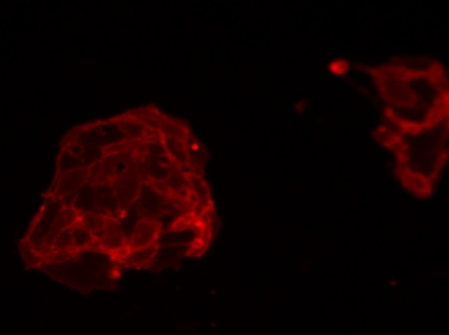
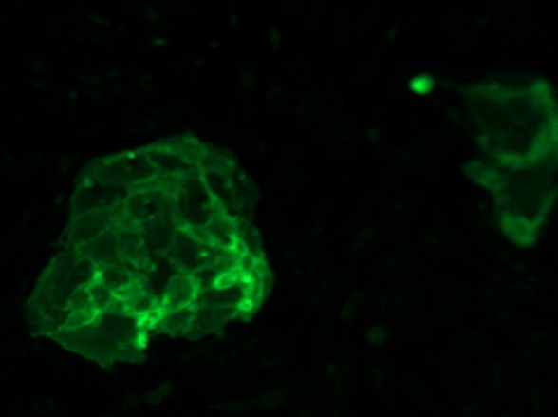
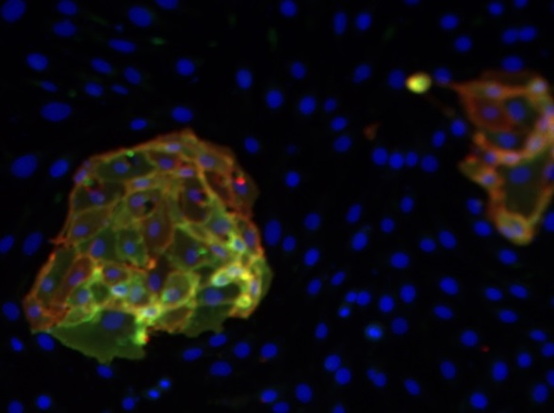
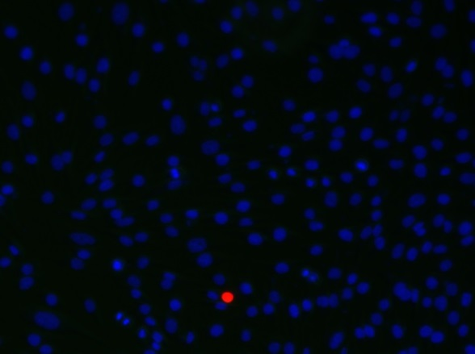
ReliaTech GmbH
Mouse anti-human CD31 #WM-59/rabbit anti-human ESAM
mouse anti-human CD31 (PE)
rabbit anti-human ESAM (ALEXA Flour 488)
ESAM / CD31
Control (goat anti-rabbit IgG ALEXA Flour 488; 1:600
Goat anti-mouse IgG-PE; 1:400)
Immunofluorescence staining of CD31 (red) and ESAM (green) in a mixture of primary human dermal lymphatic endothelial cells (HDLEC) and the mouse myoblast cell line C2C12 with monoclonal mouse anti-human CD31 #WM-59 [Cat# 101-M92] and polyclonal rabbit anti-human ESAM [Cat# 102-PA42AG]. Control with goat anti-mouse ALEXA Flour 488 [Dianova].
[(IF_LECC21406-02; 102-PA42AG / 101-M92 (5/2µg/ml), 200X]
http://www.reliatech.de / info@reliatech.de

